Slide 1
Assignment #9
Balance Trees – Due March 28
Label steps and use a tool (not handwritten)
No late assignments

Slide 2
#1 Insertion in this AVL Tree
Insert 98
48
32
50
17
44
49
78
62
88

Slide 3
#2 Removal from this AVL Tree
Remove 32
48
32
78
22
50
88
49
64
92

Slide 4
#3 Splaying
Splay 16
8
3
10
4
11
6
12
5
7
15
13
16
14

Slide 5
#4 Splaying
Delete 7
8
3
10
4
11
6
12
5
7
15
13
16
14

Slide 6
#5 Insertion into a Splay Tree
Insert 15, 35, 25, 55, 45, 85, 95, 65, 75 into a Splay tree

Slide 7
#6 Insertion into a 2-4 Tree
Insert 15, 35, 25, 55, 45, 85, 95, 65, 75 into a 2-4 tree

Slide 8
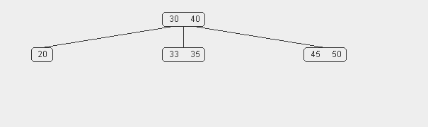
#7 Delete from a 2-4 Tree
Remove node 45 and then node 50 from this 2-4 tree (show all steps)

Slide 9
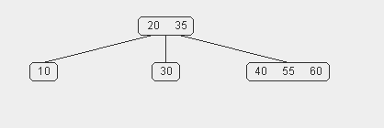
#8 Delete from a 2-4 Tree
Remove node 35 from this 2-4 tree

Slide 10
#9 Insertion into a Red-Black Tree
Insert 15, 35, 25, 55, 45, 85, 95, 65, 75 into a red black tree

Slide 11
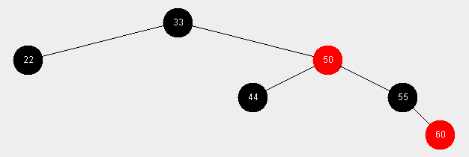
#10 Remove from a Red-Black Tree
Delete 55 and then 22 from this red black tree (show all steps)

Slide 12
#11 Remove from a Red-Black Tree
Remove 50 and then 55 from this red black tree (show all steps)

Slide 13
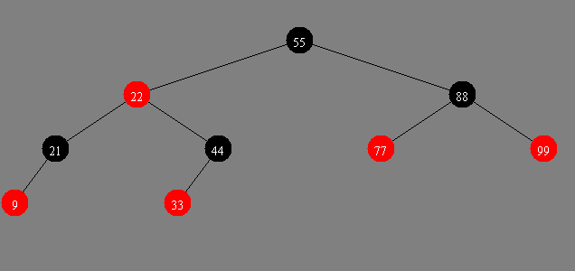
#12 Remove from a Red-Black Tree
Remove 22 (show all steps)

Slide 14
#13 Conversion
10
4
14
2
6
12
18
8
16
20
Convert this red-black tree to a 2-4 tree

